Slide 1
Vitamin D and COVID-19
September 12, 2020
William B. Grant, Ph.D.
Sunlight, Nutrition and Health Research Center
San Francisco, CA, USA
williamgrant08@comcast.net

Slide 2
Outline
Vitamin D mechanisms related to COVID-19
Observational studies of 25(OH)D, COVID-19
Treatment of COVID-19 with vitamin D
Recommendations

Slide 3
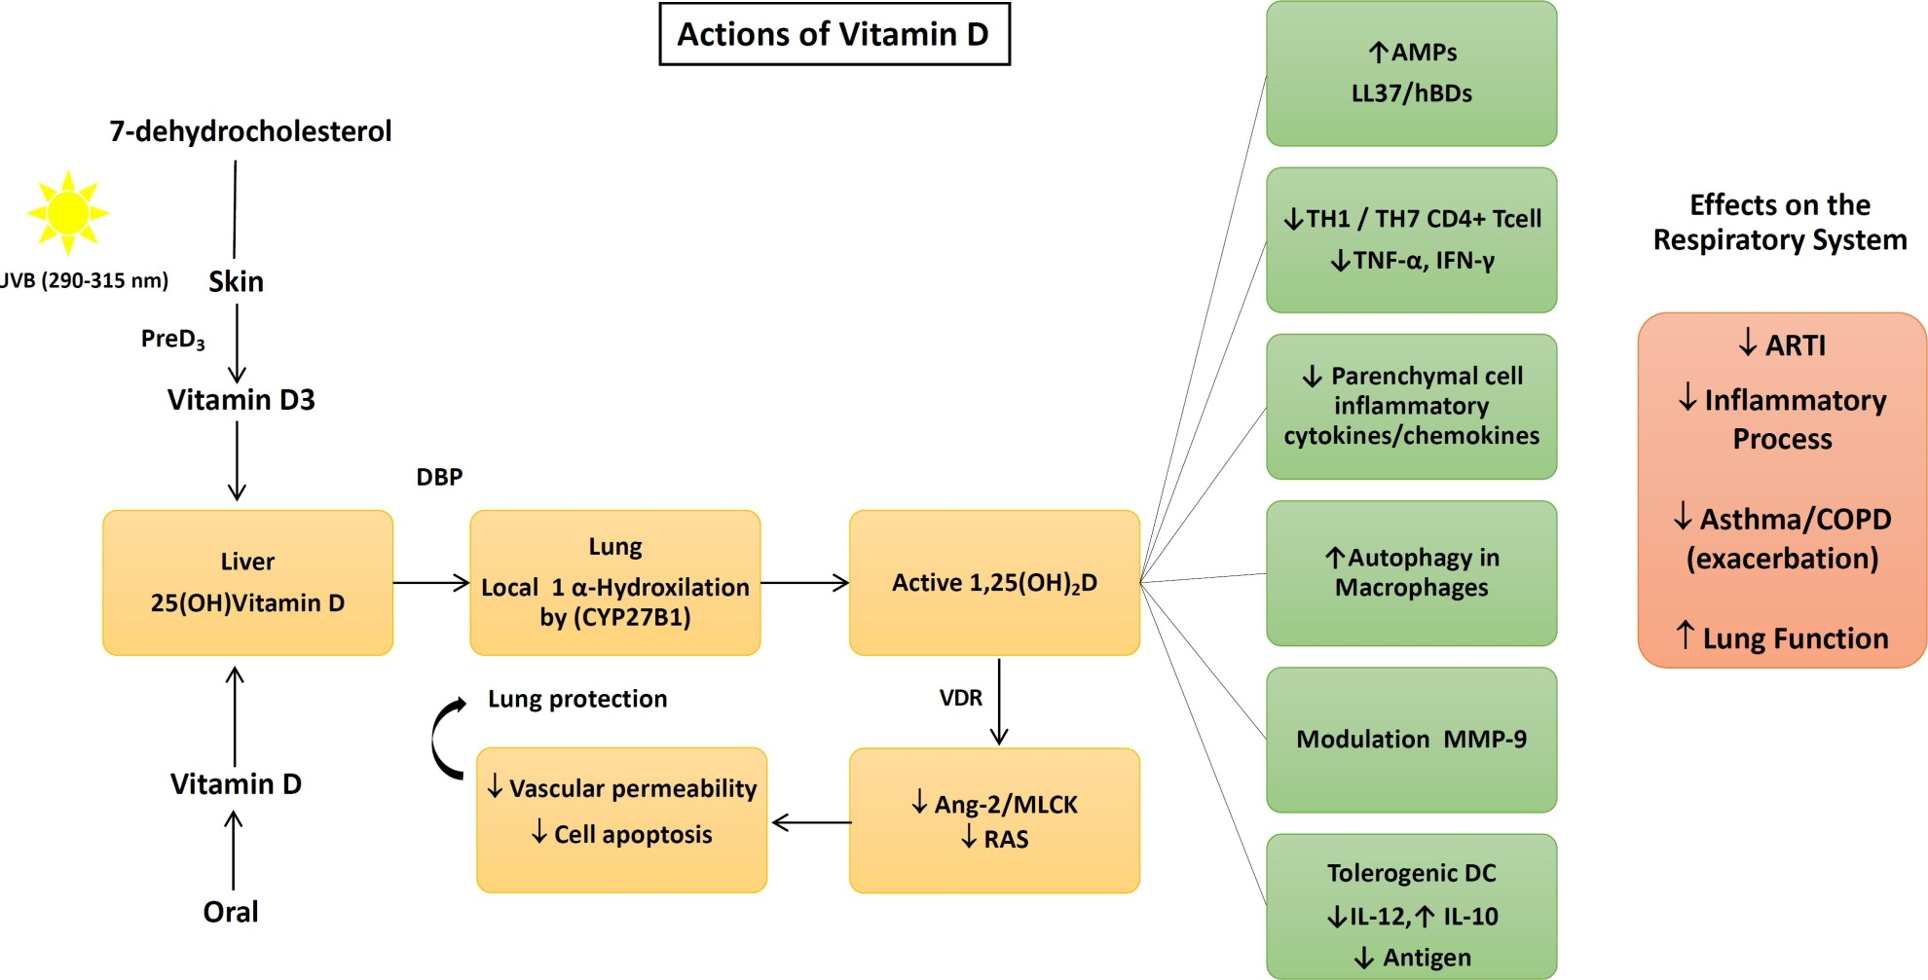
Mechanisms of Vitamin D against COVID-19
Dos Santos et al. Arch Endocrinol Metab.
2020;S2359-39972020005006214.

Slide 4
Human Cathelicidin (LL37)
Cathelicidin is a polypeptide with antimicrobial and antiendotoxin properties.
Cathelicidin is induced from macrophages by the action of 1,25(OH)₂D.
It reduces survival of viruses by puncturing the their surface, with or without an envelope.

Slide 5
Pro-inflammatory Cytokines
The body’s innate immune system can fight viral infections by increasing production of pro-inflammatory cytokines (chemical messengers).
Cytokines associated with severe COVID-19: interleuken-6 (IL-6), IL-21, IL-23, IL-33.
Perlman, Nature 20 Aug. 2020;584:345-6.
Lucas et al., Nature 20 Aug. 2020;584:463-9.
Vitamin D reduces concentrations of these and other pro-inflammatory cytokines.

Slide 6
Cytokine Storm
When the innate immune system produces too many pro-inflammatory cytokines, the resulting “cytokine storm” can damage the epithelial layer of the lungs, vascular system, and other organs as well as increase risk of pneumonia.
Vitamin D reduces risk of the “cytokine storm”.

Slide 7
Pandemic Influenza, 1918-19
During the pandemic influenza in the U.S., 1918-9, the primary cause of death was from ensuing pneumonia.
The U.S. Public Health Agency surveyed people in 12 communities to determine case-fatality rates.
Communities in the southwest had lower rates than in the northeast.
We attributed the difference to solar UVB producing vitamin D and reducing the risk of the cytokine storm.
Grant WB, Giovannucci E.Dermatoendocrinol. 2009 Jul;1(4):215-9.

Slide 8
Systemic Inflammation vs. Age
The elderly have more systemic inflammation due to “Inflamm-aging” and greater risk of COVID-19.
The young have little system inflammation.
Thus, the young are less likely to develop severe COVID-19.
Franceschi C, Bonafè M, Valensin S, Olivieri F, De Luca M, Ottaviani E, De Benedictis G. Inflamm-aging. An evolutionary perspective on immunosenescence. Ann N Y Acad Sci. 2000 Jun;908:244-54.

Slide 9
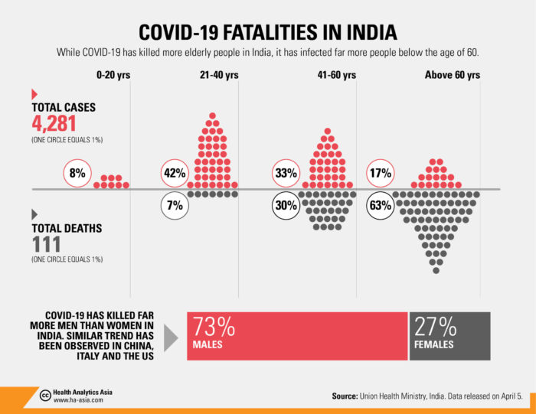
COVID-19 Case and Death Rates by Age in India

Slide 10
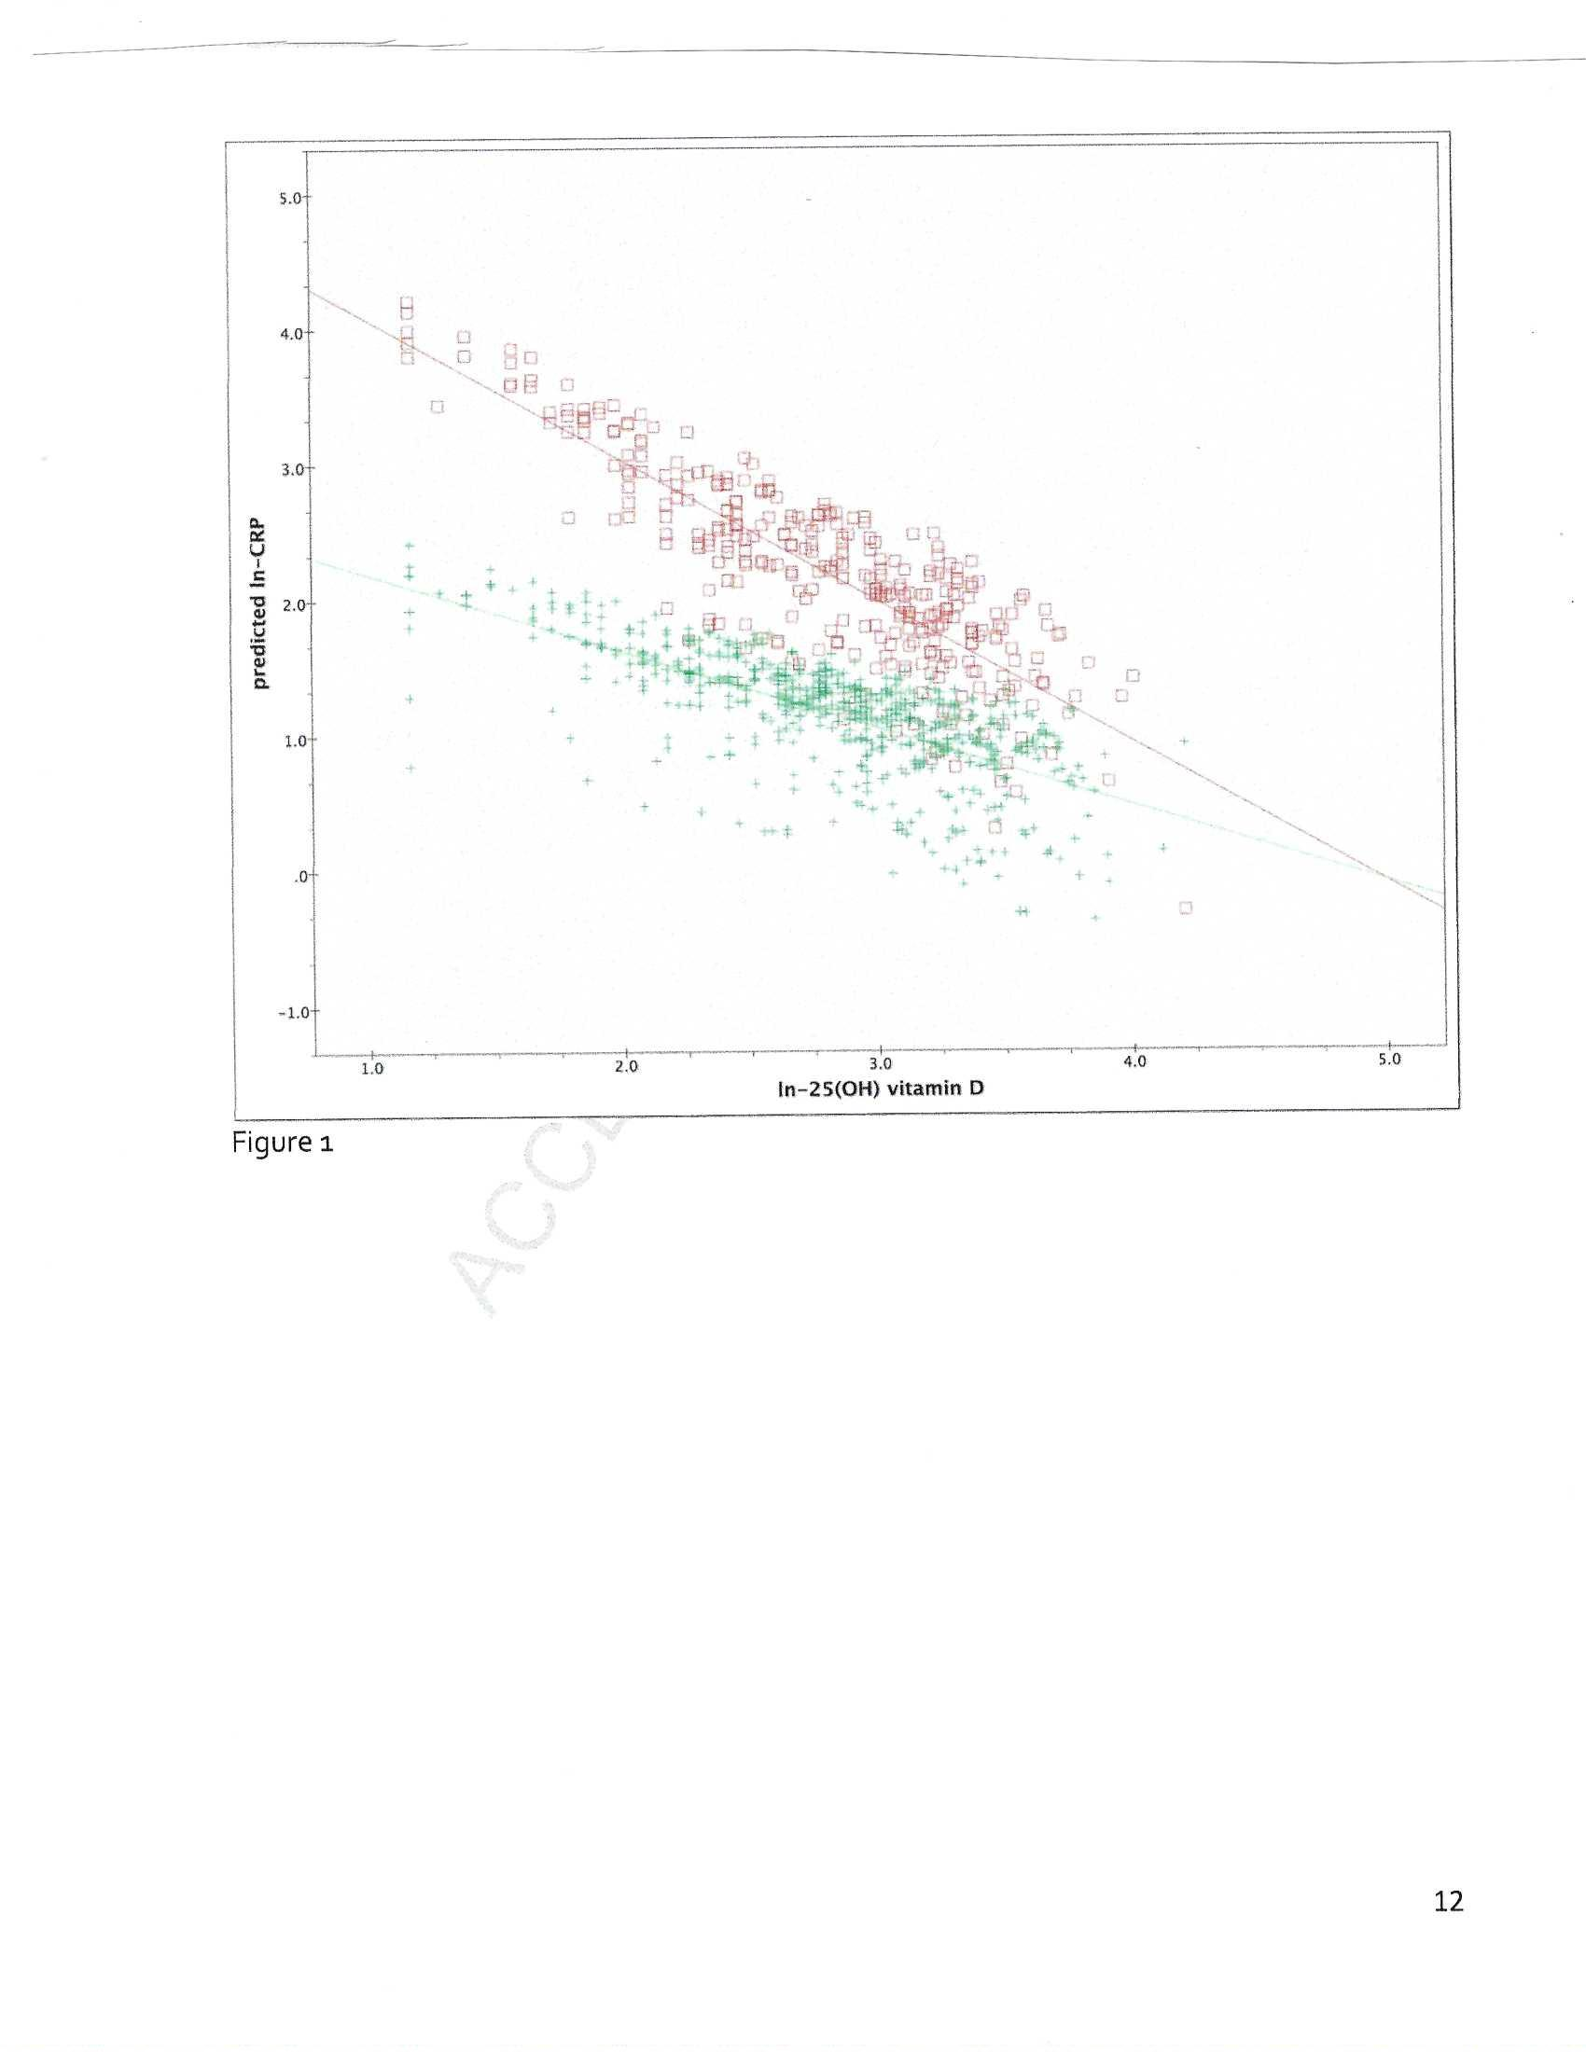
The association between vitamin D and C-reactive protein levels in patients with inflammatory and non-inflammatory diseases.
Kruit A, Zanen P.
Clin Biochem. 2016;
49(7-8):534-7.

Slide 11
Matrix metallopeptidase 9 (MMP-9)
Matrix metallopeptidase 9 (MMP-9), is a matrixin, a class of enzymes that belong to the zinc-metalloproteinases family involved in the degradation of the extracellular matrix.
Increased for COVID-19 patients with respiratory failure [Ueland, J Infect. 2020;81:e41]
Vitamin D reduces production of MMP-9 [Oh et al. J Periodontal Implant Sci 2019;49(5):270-286.
Smoking and air pollution increases MMP-9 production [Liu et al. Respir Res. 2020 Jun 26;21(1):161.]

Slide 12
Observational Studies: 25(OH)D and Severity of COVID-19
Country | Number of COVID-19 patients | Findings re 25(OH)D (ng/ml)
Belgium | 109 M, 77 F | inverse for M, not for F
Israel | 782 | OR = 1.95 (0.99-4.78) But age more import
Mexico | 172 in hospital | Mean = 16±7 For <8, OR_{death} =3.7 (1.6-8.4)
Russia | 22 severe 55 moderate | 12±6 18±14
Switzerland | 27 | PCR+: 10 PCR-: 25
UK | 44moderate 17 ICU | 19±15 14±7
The COVID-19
RT-PCR test is
a real-time reverse
transcription
polymerase chain
reaction
(rRT-PCR)
test for the
qualitative
detection of
nucleic
acid from
SARS-CoV-2

Slide 13
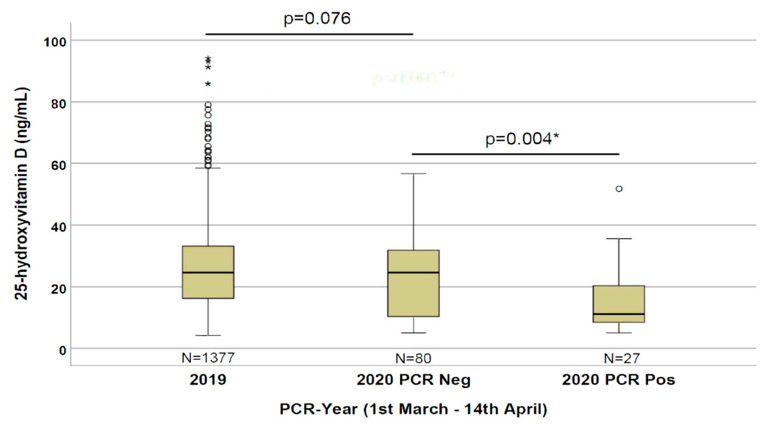
Switzerland
D'Avolio, A., et al. (2020). "25-Hydroxyvitamin D Concentrations Are
Lower in Patients with Positive PCR for SARS-CoV-2." Nutrients 12(5).
PCR, polymerase chain reaction

Slide 14
Very Elderly COVID-19 Patients
A study in the UK studied 70 COVID-19 patients aged 80±9 years admitted to a hospital in Slough, UK between 1 March and 30 April.
Many had chronic diseases. In comparison with 35 COVID-19 negative patients (controls), none of the diseases was significantly associated with COVID-19.
Median 25(OH)D for COVID-19: 11 (8-19) ng/ml.
Median 25(OH)D for controls: 21 (13-29) ng/ml.
P value for difference: 0.0008 (highly significant)
Baktash et al. Postgrad Med J 2020 doi: 10.1136/postgradmedj-2020-138712

Slide 15
COVID-19: Survival vs. 25(OH)D in Patients with Acute Respiratory Failure
Methods In this retrospective, observational study, we analysed demographic, clinical and laboratory data of 42 patients with acute respiratory failure due to COVID-19, treated in Respiratory Intermediate Care Unit (RICU) of the Policlinic of Bari, Italy, from March, 11 to April 30, 2020.
Mean 25(OH)D = 20±12 ng/ml. A survival analysis highlighted that, after 10 days of hospitalization, patients with 25(OH)D <10 ng/ml had a 50% mortality probability, while those with vitamin D ≥10 ng/ml had a 5% mortality risk (p = 0.02).
Carpagnano et al., J Endocrin Investigation. Aug. 9, 2020

Slide 16
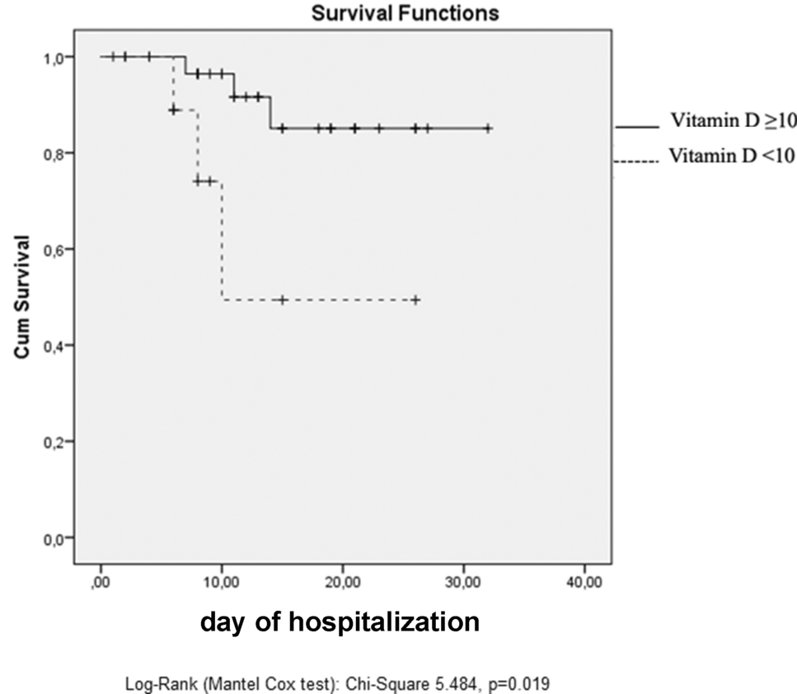
COVID-19: Survival vs. 25(OH)D in Patients with Acute Respiratory Failure
B
ng/ml
ng/ml
Carpagnano et al., J Endocrin
Investigation. Aug. 9, 2020

Slide 17
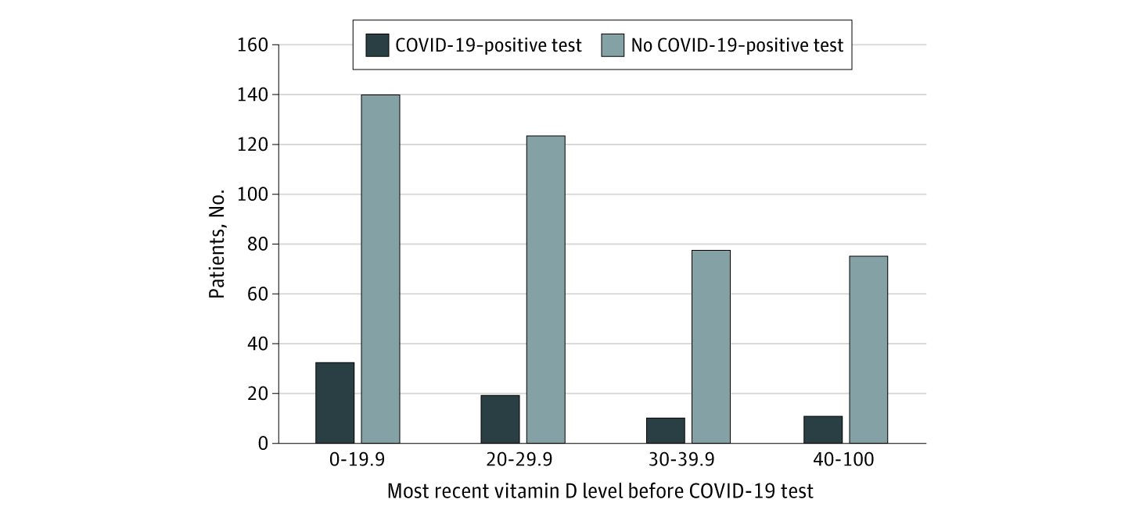
Association of Vitamin D Status and Other Clinical Characteristics With COVID-19 Test Results
Study in Chicago, IL, USA
Mean age 47±20 yrs
White: 158; other 331
25(OH)D in past 12 mos.
25(OH)D, N, Relative risk (RR)
<20 ng/ml, 124, 1.8 (1.1, 2.8)
>20 ng/ml, 187, 1.00
RR for non white 2.5 (1.3, 5.1)
Ng/ml
Meltzer et al. JAMA Netw Open.
2020;3(9):e2019722.

Slide 18
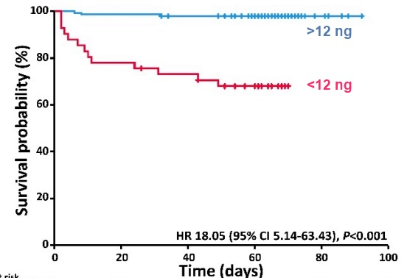
Much More Likely to Die of COVID-19 if 25(OH)D <12 ng/ml
Based on 185
Patients in Germany
HR 15 (95% CI 4–52,
p < 0.001)
Nutrients 2020, 12(9), 2757;
https://doi.org/10.3390/nu12092757

Slide 19
U.S.A. – Treatment with Vitamin D
Two Hispanic patients with BMI ~30 kg/m², no diabetes or hypertension, and baseline 25(OH)D ~20 ng/ml were given 50,000 IU/d vitamin D₂ for 5 days. 25(OH)D increased to ~40 & 50 ng/ml.
Oxygen use decreased from 15 L to 0 for one.
IL-6 decreased from 10 &14 pg/mL to <5 pg/ml.
Hospital stay 10 days for treated patients vs. 13 and 14 days for controls with diabetes mellitus and hypertension.
Ohaegbulam KC et al. Am J Therapeutics, 2020

Slide 20
"Effect of Calcifediol Treatment and best Available Therapy versus best Available Therapy on ICU Admission and Mortality Among Patients Hospitalized for COVID-19: A Pilot Randomized Clinical study"
All hospitalized patients received as best available therapy the same standard care, (per hospital protocol), of a combination of hydroxychloroquine and azithromycin. Eligible patients were allocated take oral calcifediol (0.532 mg), or not. Patients in the calcifediol treatment group continued with oral calcifediol (0.266 mg) on day 3 and 7, and then weekly until discharge or ICU admission.
Calcifediol is 25(OH)D₂ and 0.532 mg is approximately equivalent to 65,000 IU vitamin D₂.
Thus, week one treatment: 130,000 IU vitamin D₂.

Slide 21
"Effect of Calcifediol Treatment and best Available Therapy versus best Available Therapy on ICU Admission and Mortality Among Patients Hospitalized for COVID-19: A Pilot Randomized Clinical study"
Results: Of 50 patients treated with calcifediol, one required admission to the ICU (2%), while of 26 untreated patients, 13 required admission (50%) p value X² Fischer test p < 0.001.
Multivariate Risk Estimate Odds Ratio for ICU in patients with Calcifediol treatment vs. without Calcifediol treatment ICU (adjusting by Hypertension and T2DM): 0.03 (95%CI: 0.003-0.25). Of the patients treated with calcifediol, none died, and all were discharged, without complications. The 13 patients not treated with calcifediol, who were not admitted to the ICU, were discharged. Of the 13 patients admitted to the ICU, two died and the remaining 11 were discharged.
Castillo et al. J Steroid Biochem Mol Biol. 2020 Aug 29;105751.

Slide 22
COVID-19-Vitamin D Summary
Severity of COVID-19 is inversely correlated with 25(OH)D up to above 30 ng/ml.
Risk of death is greatest for 25(OH)D <12 ng/ml).
If vitamin D deficient, should take a bolus dose of vitamin D₃, followed by 2000-4000 IU/d.
Those at greatest risk of both incidence and death are the elderly, those with cardiovascular disease, diabetes, hypertension, lung disease, and the obese.
Vitamin D supplementation reduces risk of COVID-19 incidence and death; many randomized controlled trials are in progress.

